Slide 1
SOFTDEV | NDRRMC – Logistics System

Slide 2
PROJECT TEAM
JIMENEZ Project Manager | Project Analyst | Developer
ABUEL Lead Project Developer | QA Analyst
CORONEL Lead Documenter | Assistant QA Analyst
DELA CRUZ Assistant Documenter | QA Analyst

Slide 3
OVERVIEW
NDRRMC
12 Different Cluster
Logistics Cluster Responsibilities
Problem
Notes:
National Disaster Risk Reduction and Management Council
12 Clusters -->
Camp Coordination and Camp Management,
Education,
Emergency Telecom,
Food & Non-Food Items,
International Humanitarian Relations,
Law and Order,
Logistics,
Management of the Dead and the Missing,
Protection (IDP),
Psycho Spiritual Integration,
Search, Rescue,
Retrieval, and Water, Sanitation, Health (WaSH)
The NDRRMC – Logistics cluster, headed by the Office of Civil Defense, acts as the lead office for Response Cluster in disaster response operations.
They takes charge of establishing standard operating procedures on pre-disaster, during disaster, and post-disaster phase which involves inventory of available assets and resources, procurement and allocation of assets and resources, receives and facilitates requests for logistical support, provides feedback to requesting DRRMCs and local government of affected areas, tracking of cargo to its destination, updates on road conditions, warehouses stocks and cargo capacities, and other logistics services.
Does not only response to natural calamities, but also to man-made events such as terrorist attacks, Pope Visitation
The common problem that needs to be addressed in times of disaster response operations are the lack of coordination, cooperation and communication among different government agencies which leads to disorderly procurement and allocation of resources, duplication of requests, inaccurate inventory, unsystematic organization, missing cargo, and scarcity due to improper handling of supplies.

Slide 4
CONCEPTUAL FRAMEWORK

Slide 5
PROGRAM MODULES
User Management Module
Procurement Module
Location Module
Notes:
Different users – Regional Admin, Provincial Admin, City Municipal Admin, External User
Procurement Module – Resources, Suppliers, Request
Transport – Vehicle, Location

Slide 6
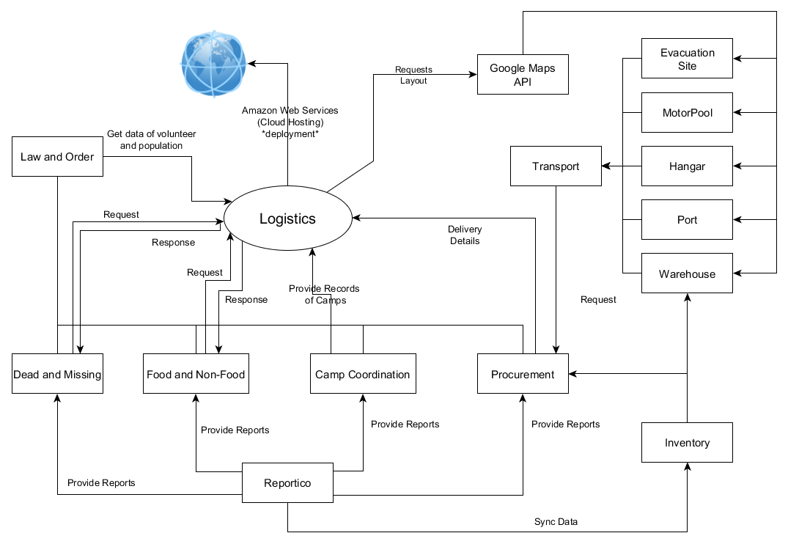
CONTEXT LEVEL DIAGRAM

Slide 7
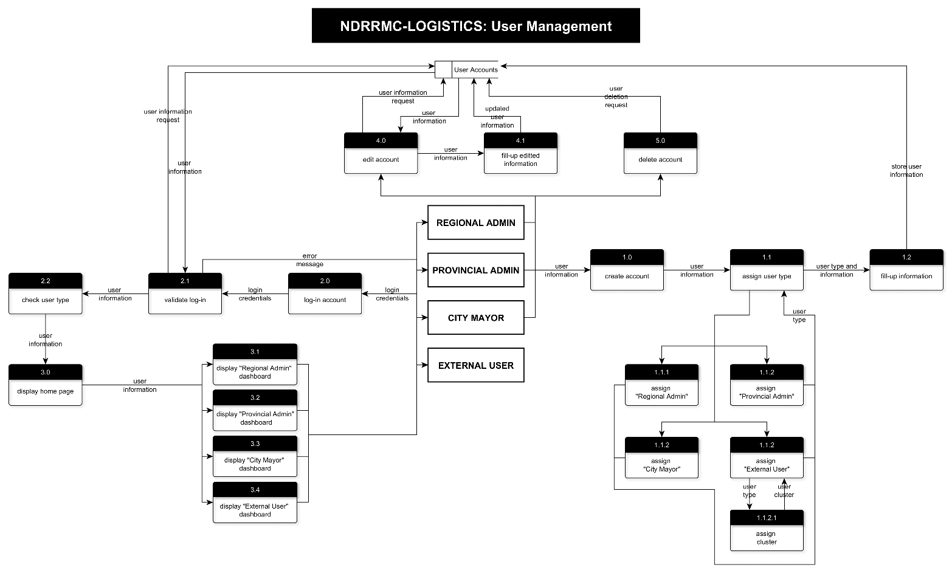
DATA FLOW DIAGRAM
USER MANAGEMENT

Slide 8
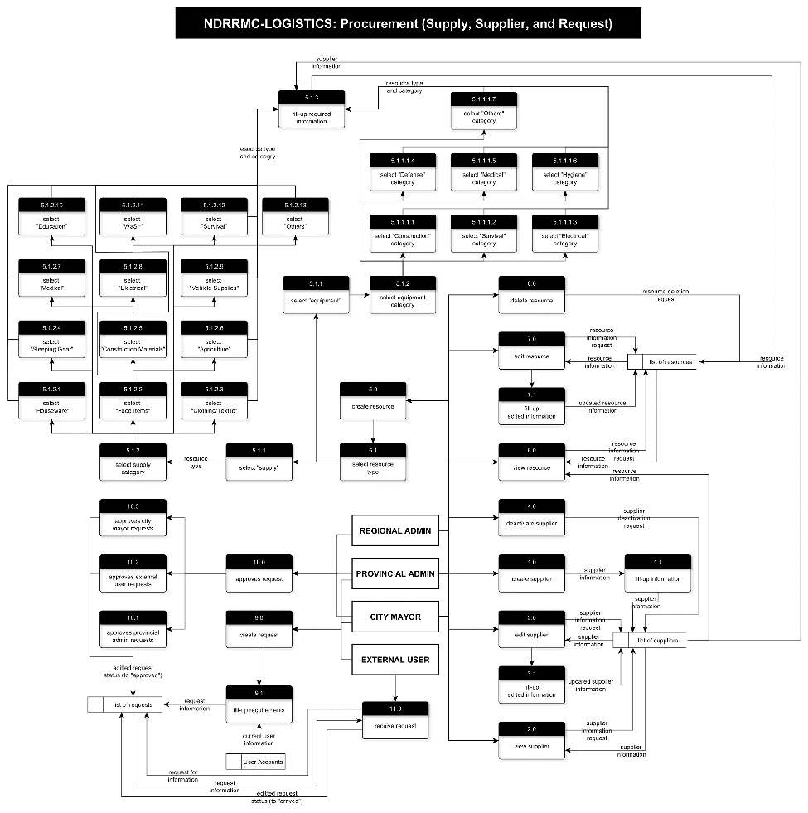
DATA FLOW DIAGRAM
PROCUREMENT

Slide 9
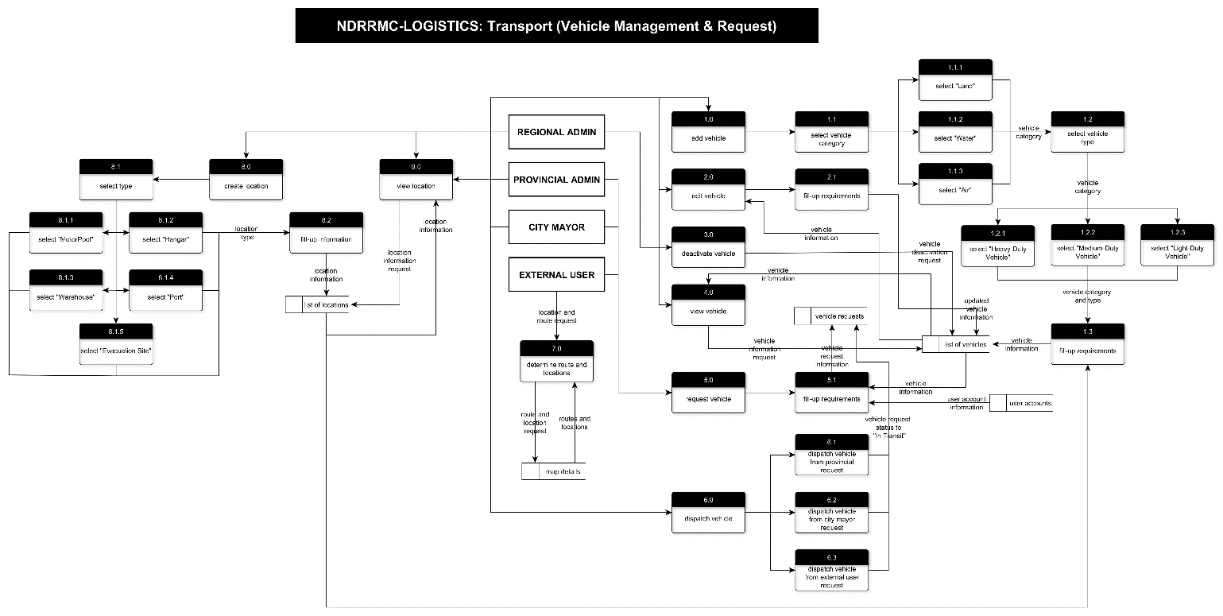
DATA FLOW DIAGRAM
TRANSPORT MANAGEMENT

Slide 10
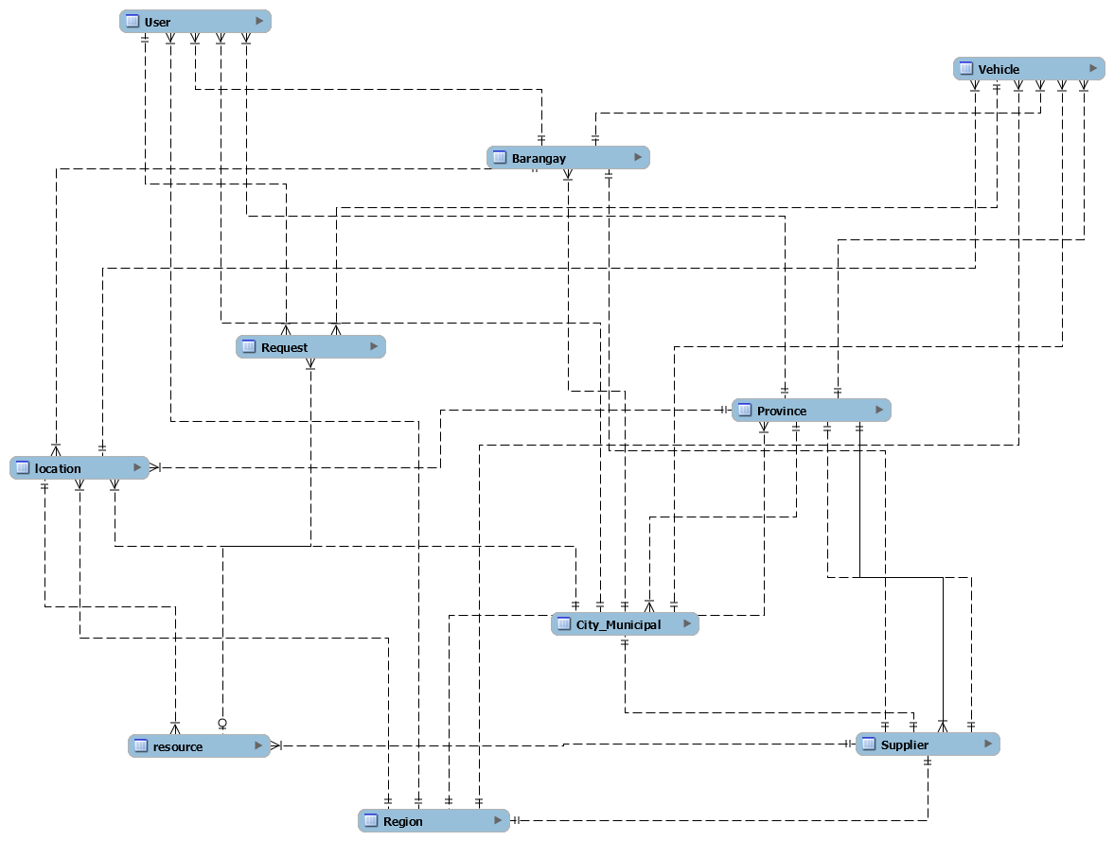
ERD

